Slide 1

News Aggregator
Rishabh Sharma -2115000845
Tigmanshu Mehta -2115001045
Vishal Sharma-2115001131
GLA University, Mathura
B. tech(CS)
Nov 24 ,2023

Slide 2
Introduction
A news aggregator is a digital platform or application that collects and curates news content from various sources across the internet and presents it to users in a centralized and easily accessible format.
The motivation behind a news aggregator project is to simplify the news consumption process and time saving etc.
The audience can expect a streamlined and user-friendly news consumption experience .

Slide 3
Objectives
Objectives of our mini project
Data Collection
Real-time Update
Search Functionality
Customization Options
Source Diversification
What you aim to achieve with this project
Efficient News Consumption
Diverse Information
User Engagement
Accessibility
Real-time Update

Slide 4
Problem Statement
Problem we are addressing
Information Overload
Fragmented News Source
Limited Time Efficiency
Lack of Personalization
Why is it important or relevant?
Efficient Information Consumption
Time Saving
Real-time Updates
Accessibility

Slide 5
Literature Review
Projects in the same domain
Gppgle News
Flipboard
Feedly
Apple News
Highlight the gap our project is filling
Customization options
Real-time updates
No-Access limited

Slide 6
Methodology
Approach took to solve the problem
Requirement Analysis
Data Collection
User Interface Design
Real-time Updates
Feedback Mechanism
Algorithms, techniques, tools, languages used

Slide 7
System Architecture
Architecture of system
The frontend of the system, where users interact with the platform . Responsible for displaying news articles, categories, and user-specific recommendations . Includes features such as user registration, profile management, and social interactions.
Web Server : Handles incoming requests from users' browsers . Routes requests to the appropriate backend services . Manages user sessions and authentication.
Backend Services: Comprises several microservices responsible for different aspects of the system . News Aggregation Service: Gathers news articles from various sources and APIs. Implements logic for filtering, categorizing, and storing news data.
User Management Service: Manages user registration, authentication, and profile information .
Recommendation Service: Utilizes machine learning algorithms to provide personalized news recommendations to users .
Social Interaction Service: Handles user interactions, comments, and social sharing features .

Slide 8
Database : Stores persistent data such as user profiles, news articles, and user interactions . Depending on the system's scale, different types of databases may be used (e.g., relational databases for structured data, NoSQL databases for flexibility and scalability).
APIs and Integrations : Integrates with external news sources and APIs to fetch up-to-date news content . Provides APIs for potential third-party integrations and future scalability.
Components
UI , Web Server , Backend Service , Database , API, Caching Layer

Slide 9
Implementation
Implementation process
Planning and Design
Data Collection
User Interface Design
Real-time Updates
Customization Features
Code snippets or screenshots if applicable

Slide 10
Features
Key features
User Authentication
Content Aggregation
Real-time Updates
Customization Options
Search Functionality
Any unique functionalities
Sentiment Analysis
Interactive Visualization
AI-driven Summarization
Localized News Alerts

Slide 11
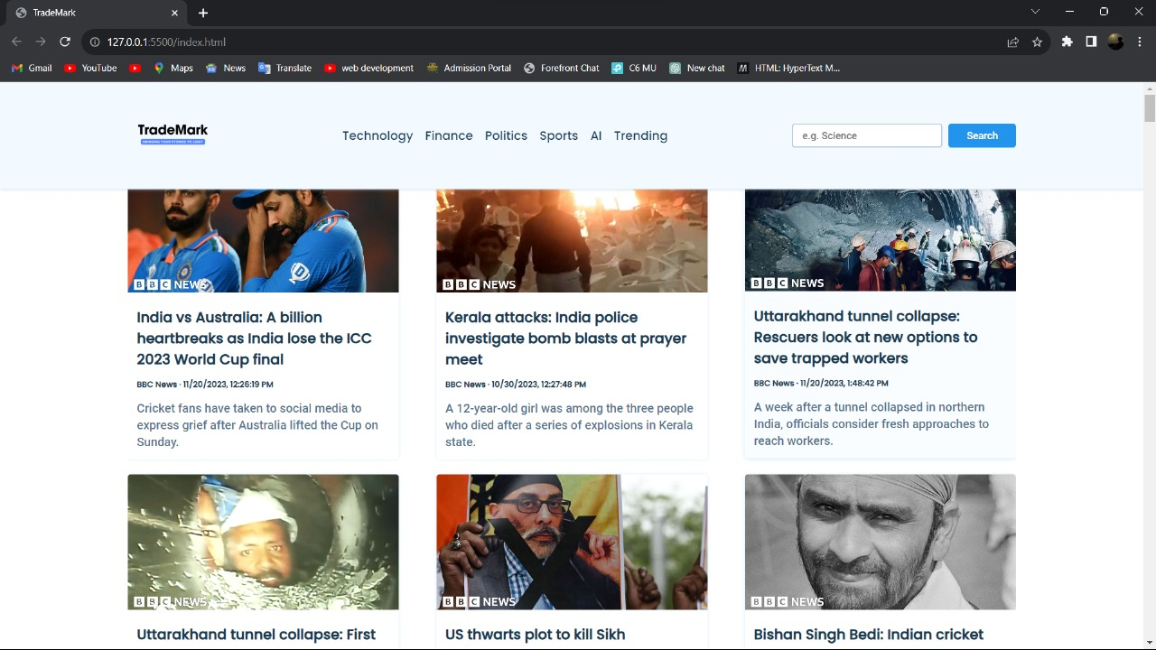
Results
Visual representation

Slide 12
Challenges Faced
Challenges or obstacles
Data Quality and Consistency
User Privacy concerns
Legal and Copyright Issues
Algorithm Bias
Real-time Updates and Scalability
Overcame them
Addressing these challenges requires a combination of technical expertise, ongoing communication with users, collaboration with legal advisors, and a commitment to ethical and user-centric development practices.

Slide 13
Future Work
Improvement in the future
Multimedia Integration
Collaborations and Partnerships
Fact-Checking Mechanisms
Additional features or functionalities
Offline Reading Mode
Language Preferences
Expert Commentary
Expert Commentary

Slide 14
Conclusion
Summarize
The discussion covered the concept of a news aggregator, highlighting its relevance in addressing information overload. The news aggregator mini project was introduced with a focus on objectives, features, and customization potential. Key features included user authentication, content aggregation, personalization, and real-time updates.
Reiterate the significance of your project
The news aggregator project is significant as it endeavors to redefine the way individuals consume news, making it a more personalized, efficient, and enriching experience in the digital age.

Slide 15
Acknowledgments
We express our sincere gratitude and appreciation to all individuals and organizations who have contributed to the successful development and implementation of the News Aggregator project.
Project Team : We extend our thanks to the dedicated and talented team members who played pivotal roles in designing, developing, and deploying the News Aggregator.
Thank You

Slide 16
Q&A
Open the floor for questions from the audience

